Slide 1
CSE322
Formal Languages and Automation Theory
Lecture #4
School of Computer Science and Engineering

Slide 2
Moore and Mealy Machine
Basics:
DFA and NFA are the finite automata without Output, where Moore and Mealy are the finite automata with output.
Moore machine always give output in +1 form, if length of string is n then output will be n+1.
Example: Input String = 11010 Then
Output will be Length of String + 1 = 5+1 =6

Slide 3
Cont.
Mealy machine always give output in +0 form, if length of string is n then output will be n.
Example: Input String = 11010 Then
Output will be Length of String = 5

Slide 4

Moore Machines
Moore Machines are finite state machines with output value and its output depends only on the present state. It can be defined as (Q, q0, ∑, , δ, λ) where:
Q is a finite set of states.
q0 is the initial state.
∑ is the input symbol.
is the output symbol.
δ is the transition function which maps Q×∑ → Q.
λ is the output function which maps Q → .

Slide 5
Cont.
Moore Machine
0
0
q0/a
1
q1/b
0
q2/b
1
1

Slide 6

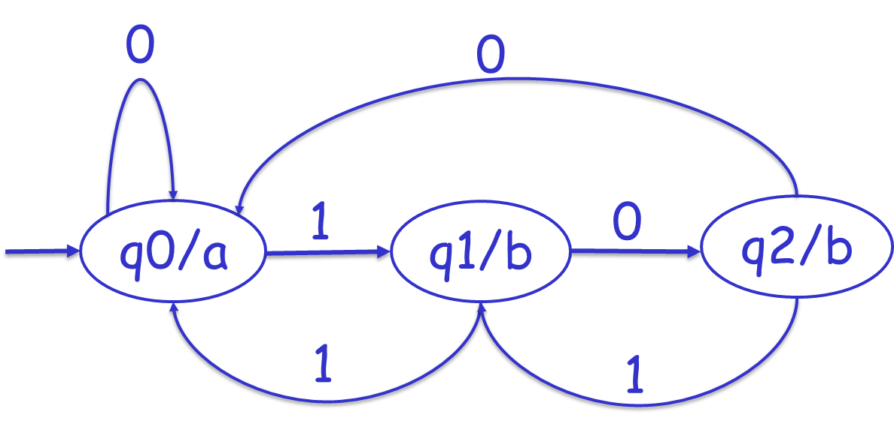
Cont.
λ : Q = (What will be Output Corresponding to states?)

Slide 7
Cont.
If Input string 101101
Then Output will be 101101= 6 + 1 =7
Output = abbbaab
0
0
q0/a
1
q1/b
0
q2/b
1
1

Slide 8
Cont.
Class Work:
Input String are as mentioned below, what will be output?
11101000
1101
0000110101
0001101010
1010101010
101011110011

Slide 9
Mealy Machines
Mealy machines are also finite state machines
with output value and their output depends on
the present state and current input symbol.
It can be defined as (Q, q0, ∑, , δ, λ’) where:
Q is a finite set of states.
q0 is the initial state.
∑ is the input symbol.
is the output symbol.
δ is the transition function which maps Q×∑ → Q.
‘λ’ is the output function that maps Q×∑→ .

Slide 10
Cont.
Mealy Machine
a/0
a/1
b/1
q0
q1
b/0

Slide 11
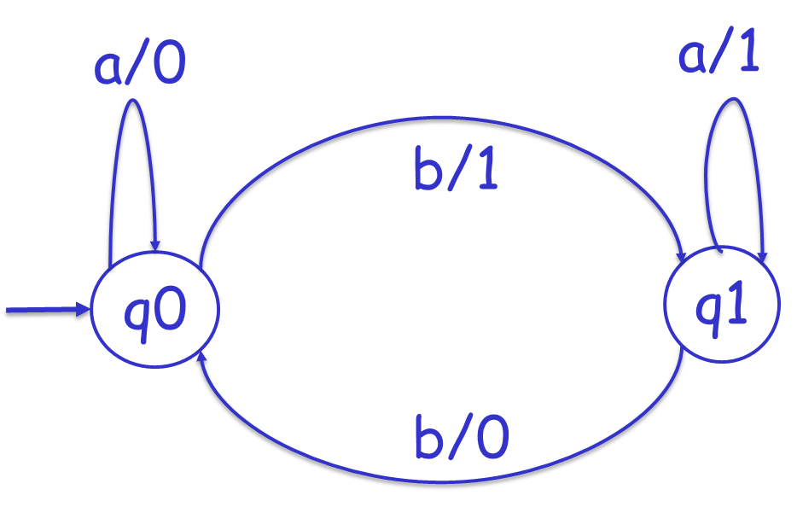
Cont.
λ : Q x ∑ -> (What will be Output Corresponding to states?)

Slide 12

Cont.
If Input string abbab
Then Output will be abbab = 5
Output = 01001

Slide 13
Cont.
Class Work:
Input String are as mentioned below, what will be output?
aaababababa
bbbbaaaa
bababaaab
babababbbaa
babaababaaa
ababababaabb

